Slide 1
Welcome!
Feel free to chat using your microphone or
the chat window while you wait.

Slide 2
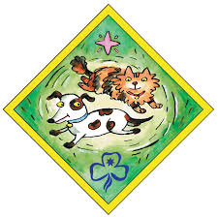
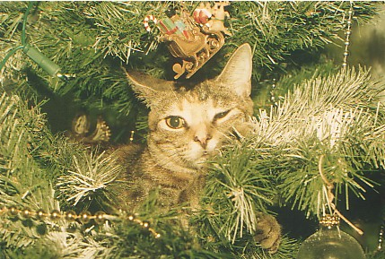
Share Your Pet . . .
Notes:
Guides show their pet on the webcam, share a photo of a past pet or discuss their most desired pet. Guides can discuss how they care for their pets – responsibilities and expectations.

Slide 3
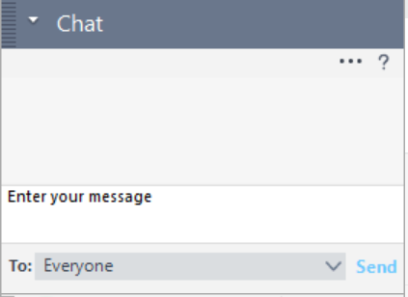
Pet Quiz
Type your answer in the chat window
1. True or false: Hummingbirds can fly backwards?
2. What do carnivores eat?
3. Which continent does the ostrich originate from?
4. Can you unscramble the following to reveal the name of an animal: DCROOCLEI?
5. Are spiders insects?
6. What type of animal are colts and fillies?
Notes:
Use the chat window to go through the pet quiz, each question will appear one at a time when played.

Slide 4
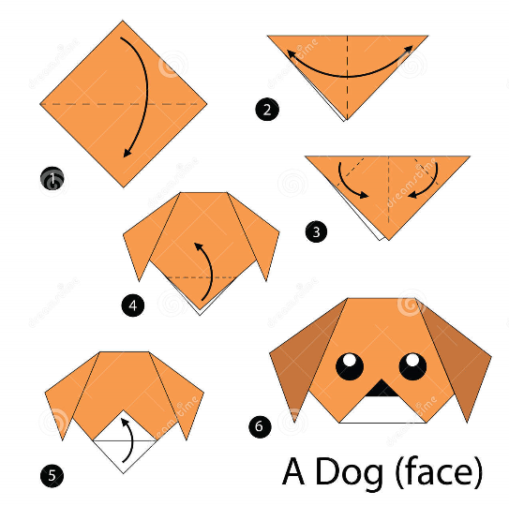
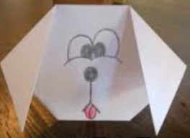
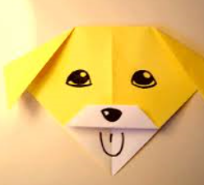
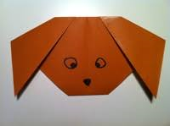
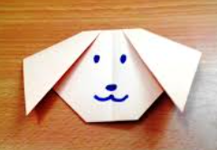
Dog Face Origami
Notes:
Demonstrate how to make and have each Guide make and share through the webcam.

Slide 5
What Animal are You?
Take the quiz and see what you are . . . http://www.kidzworld.com/quiz/what-animal-personality-are-you
Notes:
Take the test and see what animal personality you are. Emphasis on everyone being different.

